Slide 1
Employee Data Analysis using Excel
STUDENT NAME: SUBASHINI.S
REGISTER NO:2213331042146
DEPARTMENT:COMMERCE
COLLEGE: BHARATHI WOMEN'S COLLEGE

Slide 2
PROJECT TITLE
Employee Performance Analysis

Slide 3


AGENDA
Problem Statement
Project Overview
End Users
Our Solution and Proposition
Dataset Description
Modelling Approach
Results and Discussion
Conclusion
3/21/2024 Annual Review

Slide 4

PROBLEM STATEMENT
The current response time is not meeting customer expectations, which is leading to increased frustration and a decline in brand loyalty.Delays in resolving customer issues are causing a backlog in the support system, affecting overall team efficiency.

Slide 5
PROJECT OVERVIEW
.
The objective of this project is to [briefly describe the main goal or purpose of the project, e.g., "develop a new customer relationship management (CRM) system to enhance customer engagement and streamline operations."]Scope: This project will involve [outline the main activities, deliverables, and what the project will include, e.g., "design, development, testing, and deployment of the CRM system across all departments."]

Slide 6

WHO ARE THE END USERS?
Including a slide or section on end users in your PowerPoint presentation helps to focus the project's goals and ensures that the outcomes align with the needs of those who will directly interact with the results.

Slide 7
OUR SOLUTION AND ITS VALUE PROPOSITION
Solving Pain Points: [Explain how your solution addresses specific challenges, e.g., "Our platform eliminates the need for multiple tools, reducing complexity and improving efficiency."]Competitive Advantage: [Highlight what makes your solution stand out from the competition, e.g., "Unlike other CRMs, our solution offers AI-driven insights that anticipate customer needs, enhancing engagement."]

Slide 8
Dataset Description
Purpose: [Explain why this dataset is relevant, e.g., "This dataset will be used to analyze customer purchasing behavior and identify trends that can inform marketing strategies."]This slide gives a comprehensive view of the dataset, ensuring that your audience understands its composition, source, and relevance to your project. You can adjust the specifics based on your actual dataset and analysis needs.

Slide 9

THE "WOW" IN OUR SOLUTION
Innovative Design Templates: Offering a range of professionally designed, customizable templates that go beyond the typical choices.Advanced Data Visualization: Integrating sophisticated charting tools or interactive data elements that make data presentation more engaging and informative.AI-Powered Assistance: Using AI to suggest design improvements, automate repetitive tasks, or generate content ideas based on the presentation's context.
3/21/2024 Annual Review
9

Slide 10
MODELLING
Incorporate models that can be rotated, zoomed, and interacted with directly within the slides. This can be particularly effective for product demos or technical presentations.Dynamic Data Visualization Use sophisticated tools to create dynamic charts and graphs that update in real time as data changes. This is useful for presentations that involve live data or frequent updates.
10

Slide 11
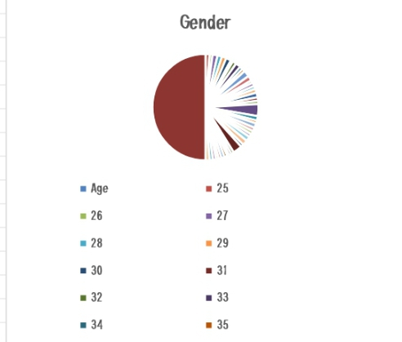
RESULTS
11

Slide 12
conclusion
Summarize Key Points: Recap the main findings or arguments presented in the slides. Use bullet points or a concise summary slide to reinforce the key takeaways.Highlight the Impact: Emphasize the significance of the results or conclusions and how they affect the audience or the subject matter.Call to Action: Provide clear instructions on what you want the audience to do next. This could be implementing a recommendation, taking a specific action, or further research.

